Slide 1

Scrabble
By: Nick Simons, Jenna Slusar, and Caroline Whitman

Slide 2
Rules
We created the typical Scrabble game
15x15 board with a 100 piece tile bag
Use a Scrabble Dictionary to check the validity of words
Have to play the first word over the center star panel
Shuffle hand and undo, but only during your turn
You always have 7 tiles in your hand

Slide 3
Rules (continued!)
Choose the letter of a blank tile
Each turn the player has the option to
Play a word
Swap tiles
Pass
Player with highest score wins when tile bag is empty

Slide 4
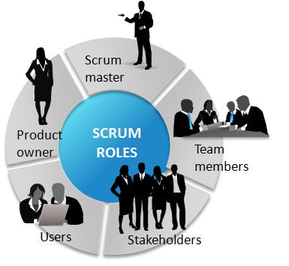
Scrum
Yodiz
Google Sheets
Working together
Developing backlogs and taskboards

Slide 5
Scrum (continued!)
User Stories
As a player
I need to connect to a network so I have other people to play against.
I need to tiles that hold letter and point values.
I would like to switch a tile in my hand with a random tile in the bag.
I want to be able to shuffle the tiles in my hand.
I want to play a word and receive a score.
As a game manager
I need to keep track of the multiple players in the game.
I need to make sure all players can access the same tile bag and Scrabble board.

Slide 6
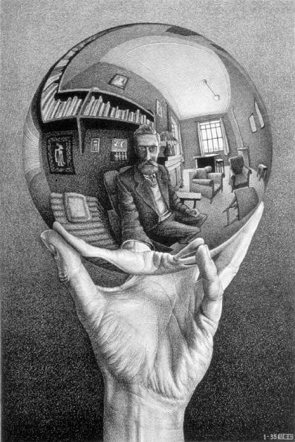
reflection
Strengths
Weaknesses
What would we change?
Notes:
strengths:
git was annoying, but we had very few major issues with it
worked well together, very willing to find time to meet
everyone was willing to help with other people’s parts to debug, etc.
weaknesses:
networking
difficulty estimating how long things would take
what would we change?
change the Tile class, probably make the Tile extend JLabel. the tile class was pretty much used for the values of the tiles and the letters, but otherwise we had to create jlabel representations of them
more refactoring. we have some classes that are insanely long, due to switches n stuff

Slide 7
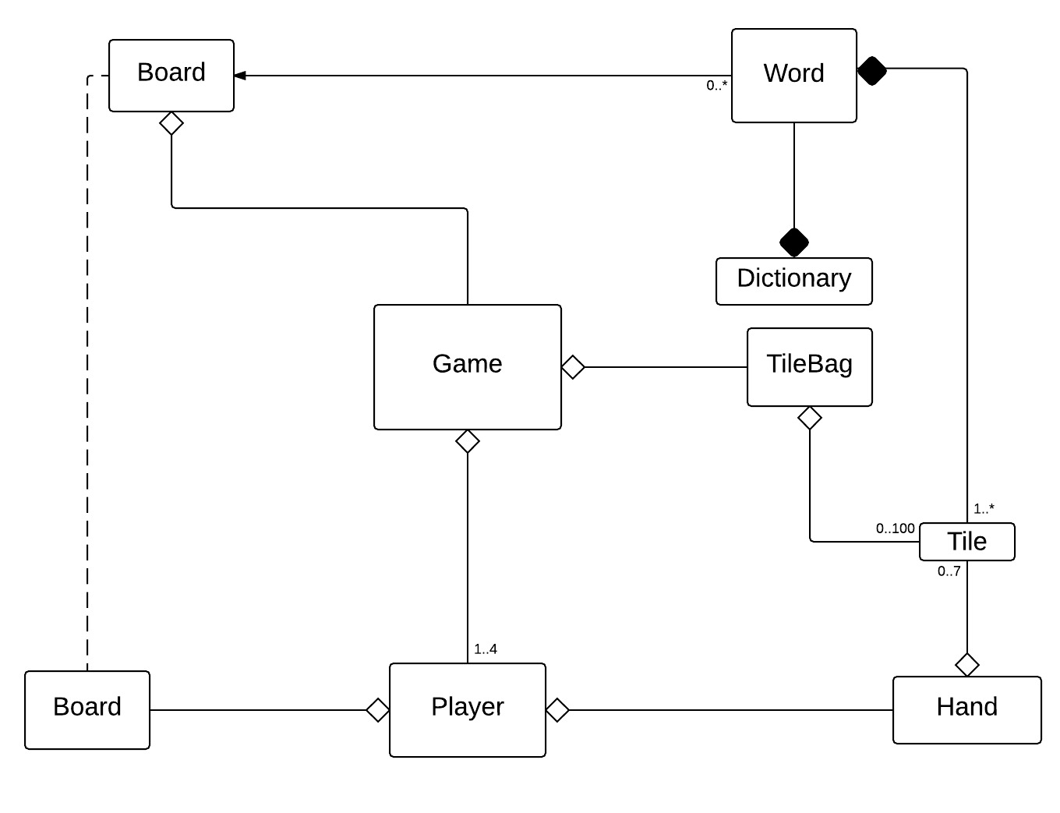
design

Slide 8
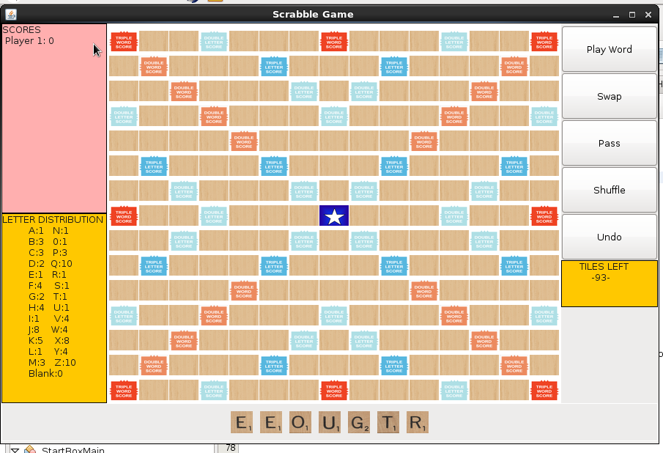
Demonstration
Notes:
explain the view of the board( normal scrabble board, more players will pop up with networking when we figure that out, tiles left is the tile bag, the letter distribution shows how much each tile is worth if you can’t see your hand, hand has 7 tiles)
then go to netbeans and run it explaining how you don’t completely have networking yet so we will just do it with one player
show how you have to play first word on star
which shows how undo button works
shuffle your hand
swap a tile, but show that it has to be in your hand, and a valid input
then play word and show that score changes, and more tiles are added to your hand, and the size of tile bag changes
say that essentially pass doesn’t do anything for one player because it’s one player, that button will work when we figure out networking
**have one already pre ran with a blank tile
show that you can choose the letter of your blank tile

